Slide 1

H2O Architecture
Insyde Software March, 2021

Slide 2
Copyright 2021 Insyde Software Corp., All Rights Reserved.
No part of this publication may be reproduced, transmitted, transcribed, stored in a retrieval system, or translated into any language or computer language, in any form, or by any means, electronic, mechanical, magnetic, optical, chemical, manual or otherwise, without the prior written permission of Insyde Software Corp.
Disclaimer
Insyde Software Corp. (“Insyde”), provides this document and the programs "as is" without warranty of any kind, either expressed or implied, including, but not limited to, the implied warranties of merchantability or fitness for a particular purpose.
This document may contain technical inaccuracies or typographical errors. Changes are periodically made to the information herein; these changes will be incorporated in future revisions of this document. Insyde is under no obligation to notify any person of the changes. Some code names featured in this document are used to identify products that are in development and not yet publicly announced for release. Insyde is not obligated for its accuracy or completeness.
This document may contain third party’s information, features, schedules, code names, and product names, which are based on Insyde’s interpretation available as of the creation of this document and may be changed from time to time. Neither Insyde nor the third party is obligated to notify such change. If you are interested in third party’s information, you may contact the local third party sales office or the local distributor to obtain the latest specifications. All the intellectual property right of any third party information remains to its owner or steward.

Slide 3
Agenda
General Overview
Security (SEC)
Pre-EFI Initialization (PEI)
Driver Execution Environment (DXE)
Boot Device Selection (BDS)
Firmware Storage
Internal Use

Slide 4
General Overview

Slide 5
General Overview Unified Extensible Firmware Interface (UEFI)
Tiano
Extensible Firmware Interface (EFI)
Defines a group of standard interfaces between the operating system (OS) and the platform firmware.

Slide 6
General Overview Platform Initialization (PI)
Vol. 1: Pre-EFI Initialization Core Interface
Vol. 2: Driver Execution Environment Core Interface
Vol. 3: Shared Architectural Elements
Vol. 4: System Management Mode Core Interface Version
Vol. 5: Standards

Slide 7
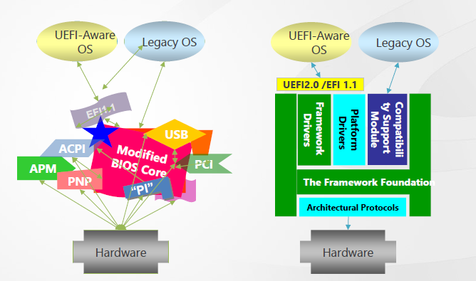
General Overview Difference between Legacy BIOS and UEFI Firmware

Slide 8
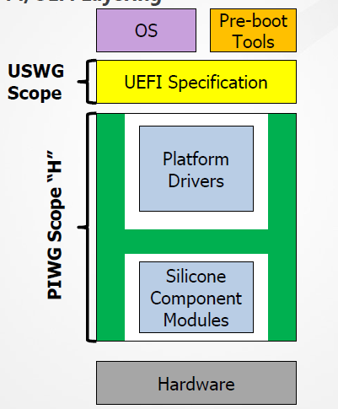
General Overview PI/UEFI Layering
UEFI Spec is about interfaces between OS, Add-in driver, and system firmware
PIWG Specs relate to making UEFI implementations
Promote interoperability between firmware components providers.
All interfaces and services produced and consumed by firmware only.

Slide 9
General Overview Platform Boot Flow: Where EFI and UEFI fit into the Platform Boot
Components Covered by EFI & UEFI
Pre Verifier
Verify
EFI/UEFI Interfaces
OS-Absent App
PEI Core
CPU Init
Device, Bus, or Service Driver
Transient OS Environment
Chipset Init
Not Covered by EFI or UEFI
Transient OS Boot Loader
Board Init
EFI Driver Dispatcher
Boot Manager
OS-Present App
Architectural Protocols
Final OS Boot Loader
Final OS Environment
Security (SEC)
Pre EFI Initialization
(PEI)
Driver Execution Environment (DXE)
Boot Dev Select (BDS)
UEFI & OS Loader Handshake
Runtime (RT)
Power On
[..Platform Initialization..]
[..OS Boot..]
Shutdown

Slide 10
General Overview Platform Boot Flow: Where PI and Framework Fit into the Platform Boot Flow
Pre Verifier
Verify
EFI/UEFI Interfaces
OS-Absent App
PEI Core
CPU Init
Not Covered by Framework & PI
Device, Bus, or Service Driver
Transient OS Environment
Chipset Init
Transient OS Boot Loader
Board Init
EFI Driver Dispatcher
Boot Manager
OS-Present App
Architectural Protocols
Final OS Boot Loader
Final OS Environment
Security (SEC)
Pre EFI Initialization
(PEI)
Driver Execution Environment (DXE)
Boot Dev Select (BDS)
UEFI & OS Loader Handshake
Runtime (RT)
Power On
[..Platform Initialization..]
[..OS Boot..]
Shutdown
Components Covered by Framework & PI

Slide 11
General Overview Platform Boot Flow: Where UEFI and PI Fit into the Platform Boot Flow
Components Covered by UEFI & PI
Pre Verifier
Verify
EFI/UEFI Interfaces
OS-Absent App
PEI Core
CPU Init
Device, Bus, or Service Driver
Transient OS Environment
Chipset Init
Transient OS Boot Loader
Board Init
EFI Driver Dispatcher
Boot Manager
OS-Present App
Architectural Protocols
Final OS Boot Loader
Final OS Environment
Security (SEC)
Pre EFI Initialization
(PEI)
Driver Execution Environment (DXE)
Boot Dev Select (BDS)
UEFI & OS Loader Handshake
Runtime (RT)
Power On
[..Platform Initialization..]
[..OS Boot..]
Shutdown

Slide 12
General Overview UEFI Conceptual Overview
OPERATING SYSTEM
EFI OS LOADER
EFI BOOT SERVICES
EFI RUNTIME SERVICES
SMBIOS
ACPI
INTERFACES FROM OTHER REQUIRED SPECS
PLATFORM HARDWARE
EFI SYSTEM PARTITION
EFI OS LOADER

Slide 13
General Overview POST Flow
PWR ON
SEC
Security
PEI
Pre-EFI Initialization
DXE
Driver Execution Environment
BDS
Boot Device Selection
OS
13

Slide 14
Security (SEC)

Slide 15
Security (SEC) Phase
Pre Verifier
Verify
EFI/UEFI Interfaces
OS-Absent App
PEI Core
CPU Init
Device, Bus, or Service Driver
Transient OS Environment
Chipset Init
Transient OS Boot Loader
Board Init
EFI Driver Dispatcher
Boot Manager
OS-Present App
Architectural Protocols
Final OS Boot Loader
Final OS Environment
Security (SEC)
Pre EFI Initialization
(PEI)
Driver Execution Environment (DXE)
Boot Dev Select (BDS)
UEFI & OS Loader Handshake
Runtime (RT)
Power On
[..Platform Initialization..]
[..OS Boot..]
Shutdown

Slide 16
Security (SEC) Phase
The Security (SEC) phase is the first phase in the PI Architecture and is responsible for the following:
Handling all platform restart events
Creating a temporary memory store
Serving as the root of trust in the system
Passing handoff information to the PEI Foundation
BootFirmwareVolume
SizeOfCacheAsRam

Slide 17
Security (SEC) Phase SEC-to-PEI Transition
SEC
Trustworthy
RAM
SEC creates an early cache as RAM memory environment
SEC knows the location of the boot firmware volume
Boot
Firmware
Volume
PEI Core
PEIMS
SEC passes control to PEI core located in the BFV

Slide 18
Pre-EFI Initialization (PEI)

Slide 19
Pre-EFI Initialization (PEI) Phase Platform Boot Flow
Pre Verifier
Verify
EFI/UEFI Interfaces
OS-Absent App
PEI Core
CPU Init
Device, Bus, or Service Driver
Transient OS Environment
Chipset Init
Transient OS Boot Loader
Board Init
EFI Driver Dispatcher
Boot Manager
OS-Present App
Architectural Protocols
Final OS Boot Loader
Final OS Environment
Security (SEC)
Pre EFI Initialization
(PEI)
Driver Execution Environment (DXE)
Boot Dev Select (BDS)
UEFI & OS Loader Handshake
Runtime (RT)
Power On
[..Platform Initialization..]
[..OS Boot..]
Shutdown

Slide 20
Pre-EFI Initialization (PEI) Phase Overview
The PEI phase will initially operate with the platform in a nascent state, leveraging only on-processor resources, such as the processor cache as a call stack, to dispatch Pre-EFI Initialization Modules (PEIMs).
These PEIMs are responsible for the following:
Initializing some permanent memory complement
Describing the memory in Hand-Off Blocks (HOBs)
Describing the firmware volume locations in HOBs
Passing control into the Driver Execution Environment (DXE) phase

Slide 21
Pre-EFI Initialization (PEI) Phase Overview
The PI Architecture requires the PEI phase to configure a system to meet the minimum prerequisites for the Driver Execution Environment (DXE) phase of the PI Architecture.
In general, the PEI phase is required to initialize a linear array of RAM large enough for the successful execution of the DXE phase elements.

Slide 22
Pre-EFI Initialization (PEI) Phase Overview
Essence of PEI:
The PEI dispatcher dispatches PEI
modules (PEIMs) in the right order.

Slide 23
Pre-EFI Initialization (PEI) Phase PEI Compenents
PEI Foundation
PEI Modules (PEIMs)
PEI Services
PEI Dispatcher
PEIM-to-PEIM Interfaces (PPIs)

Slide 24
Pre-EFI Initialization (PEI) Phase PEI Compenents
PEI Foundation
Successfully dispatching Pre-EFI Initialization Modules (PEIMs) in an orderly manner
Maintaining the boot mode
Initializing permanent memory
Invoking the Driver Execution Environment (DXE) loader
PEI Modules (PEIMs)
Pre-EFI Initialization Modules (PEIMs) are specialized drivers that personalize the PEI Foundation to the platform.

Slide 25
Pre-EFI Initialization (PEI) Phase Group of PEIMs
Platform-specific PEIMs
Processor-specific PEIMs
Chipset-specific PEIMs
PEI CIS–prescribed architectural PEIMs
Miscellaneous PEIMs

Slide 26
Pre-EFI Initialization (PEI) Phase PEIM Structure

Slide 27
Pre-EFI Initialization (PEI) Phase PEIM Components
PEI Services
The PEI Foundation establishes a system table named the PEI Services Table that is visible to all Pre-EFI Initialization Modules (PEIMs) in the system.
A PEI Service is defined as a function, command, or other capability manifested by the PEI Foundation when that service’s initialization requirements are met.

Slide 28
Pre-EFI Initialization (PEI) Phase PEIM Services
PEI Service | Description
PPI Services | Manages PPIs to facilitate inter-module calls between PEIMs.
Boot Mode Services | Manages the boot mode of the system.
HOB Services | Creates data structures called Hand-Off Blocks (HOBs) that are used to pass information to the next phase of the PI Architecture.
Firmware Volume Services | Finds PEIMs and other firmware files in the firmware volumes.
PEI Memory Services | Provides a collection of memory management services for use both before and after permanent memory has been discovered.
Status Code Services | Provides common progress and error code reporting services.

Slide 29
Pre-EFI Initialization (PEI) Phase PEIM Services
struct _EFI_PEI_SERVICES {
// The table header for the PEI Services Table.
EFI_TABLE_HEADER Hdr;
// PPI Functions
EFI_PEI_INSTALL_PPI InstallPpi;
EFI_PEI_REINSTALL_PPI ReInstallPpi;
EFI_PEI_LOCATE_PPI LocatePpi;
EFI_PEI_NOTIFY_PPI NotifyPpi;
// Boot Mode Functions
EFI_PEI_GET_BOOT_MODE GetBootMode;
EFI_PEI_SET_BOOT_MODE SetBootMode;

Slide 30
Pre-EFI Initialization (PEI) Phase PEIM Services
// HOB Functions
EFI_PEI_GET_HOB_LIST GetHobList;
EFI_PEI_CREATE_HOB CreateHob;
// Firmware Volume Functions
EFI_PEI_FFS_FIND_NEXT_VOLUME2 FfsFindNextVolume;
EFI_PEI_FFS_FIND_NEXT_FILE2 FfsFindNextFile;
EFI_PEI_FFS_FIND_SECTION_DATA2 FfsFindSectionData;
// PEI Memory Functions
EFI_PEI_INSTALL_PEI_MEMORY InstallPeiMemory;
EFI_PEI_ALLOCATE_PAGES AllocatePages;
EFI_PEI_ALLOCATE_POOL AllocatePool;
EFI_PEI_COPY_MEM CopyMem;
EFI_PEI_SET_MEM SetMem;

Slide 31
Pre-EFI Initialization (PEI) Phase PEIM Services
// Status Code
EFI_PEI_REPORT_STATUS_CODE ReportStatusCode;
// Reset
EFI_PEI_RESET_SYSTEM ResetSystem;
// I/O Abstractions
EFI_PEI_CPU_IO_PPI *CpuIo;
EFI_PEI_PCI_CFG2_PPI *PciCfg;
// Future Installed Services
EFI_PEI_FFS_FIND_BY_NAME FfsFindFileByName;
EFI_PEI_FFS_GET_FILE_INFO FfsGetFileInfo;
EFI_PEI_FFS_GET_VOLUME_INFO FfsGetVolumeInfo;
EFI_PEI_REGISTER_FOR_SHADOW RegisterForShadow;
};

Slide 32
Pre-EFI Initialization (PEI) Phase PEI Components
PEI Dispatcher
The PEI Dispatcher is essentially a state machine that is implemented in the PEI Foundation.
The PEI Dispatcher evaluates the dependency expressions in Pre-EFI Initialization Modules (PEIMs) that are in the firmware volume(s) being examined.
The dependency expressions are logical combinations of PEIM-to-PEIM Interfaces (PPIs).

Slide 33
Pre-EFI Initialization (PEI) Phase PEI Dispatcher
PEI Start
PEIM n
PEIM 3
PEIM Entry Point
PEIM 2
Initialize the dispatch of the PEI Foundation
PEIM Entry Point
PEIM 1
PEIM Entry Point
PEIM Entry Point
Invoke PEIMs
DXE IPL PEIM
Hand off to DXE IPL PPI
PEIM Entry Point
DXE IPL PPI
Load/Start DXE

Slide 34
Pre-EFI Initialization (PEI) Phase Dispatching
SEC
PEI Core
Core Services
PPI Database
Boot Mode
R/O FW Volume
Memory Service
HandOffBlocks
Status Code
Boot
Firmware
Volume
Initialization
PEI Dispatcher
TRAM
Entry
Entry
Entry
PEIM
PEIM
PEIM

Slide 35
Pre-EFI Initialization (PEI) Phase Dispatching
The PEI dispatcher examines the PEIMs in BFV for the following:
The PEIM has not yet been invoked.
The PEIM file is correctly formatted.
The PEIM is trustworthy.
The PEIM’s dependency requirements have been met.
PEI Dispatcher
Entry
Entry
Entry
PPI(s)
PEIM
PEIM
PEIM

Slide 36
Pre-EFI Initialization (PEI) Phase Dependency
PEIMs may have dependencies on one another.
Dependencies for a PEIM are recorded in a special section of the FV.
Notation
AcXpY = A consumes X and produces Y
Uses Boolean operators AND, OR and NOT
PEI Dispatcher
Entry
Entry
Entry
Use A PPI
A PPI
PEIM
PEIM
PEIM

Slide 37
Pre-EFI Initialization (PEI) Phase PEI Components
PEIM-to-PEIM Interfaces (PPIs)
PEIMs communicate with each other using a structure called a PEIM-to-PEIM Interface (PPI).
Architectural PPIs
An architectural PPI is a PPI whose GUID is described in the PEI CIS and is a GUID known to the PEI Foundation.
These were interfaces consumed by the PEI Foundation and are not intended to be consumed by other PEIMs.
Additional PPIs
Additional PPIs are PPIs that are important for interoperability but are not depended upon by the PEI Foundation.

Slide 38
Pre-EFI Initialization (PEI) Phase PPI Descriptor
EFI_PEI_PPI_DESCRIPTOR
typedef struct {
UINTN Flags;
EFI_GUID *Guid;
VOID *Ppi;
} EFI_PEI_PPI_DESCRIPTOR;
typedef struct _EFI_PEI_NOTIFY_DESCRIPTOR {
UINTN Flags;
EFI_GUID *Guid;
EFI_PEIM_NOTIFY_ENTRY_POINT Notify;
} EFI_PEI_NOTIFY_DESCRIPTOR;

Slide 39
Pre-EFI Initialization (PEI) Phase PPI Example
PEI Cache PPI
GUID Definition
#define PEI_CACHE_PPI_GUID \
{0xc153205a, 0xe898, 0x4c24, 0x86, 0x89, 0xa4, 0xb4, 0xbc, 0xc5, 0xc8, 0xa2};
Procedure Template
typedef
EFI_STATUS
(EFIAPI *PEI_SET_CACHE_PPI) (
IN EFI_PEI_SERVICES **PeiServices,
IN PEI_CACHE_PPI *This,
IN EFI_PHYSICAL_ADDRESS MemoryAddress,
IN UINT64 MemoryLength,
IN EFI_MEMORY_CACHE_TYPE MemoryCacheType
);

Slide 40
Pre-EFI Initialization (PEI) Phase Notification
Provides a simple call-back mechanism for PEIMs
Occurs on installation of a PPI
Registered with the PEI Core with a Notify Descriptor
Allows a PEIM to register the service that will be invoked upon installation of another service

Slide 41
Pre-EFI Initialization (PEI) Phase Memory Switch
The Core “switches” memory when real system memory is found
Migrates private data and any pointer there
Installs PPI notification to all PEIMs that the real memory has been found
Allows PEIMs to perform further “memory switch” operations
BFV
FV(s)
TRAM
Entry
PPI(s)
System
Memory
PEIM

Slide 42
Pre-EFI Initialization (PEI) Phase End Condition
A dispatch pass is done when no PEIM is dispatched during a pass through the known PEIMs
Done with dispatch: Invoke the DXE Initial Program Load (IPL)
PEI Dispatcher
BFV
FV(s)
TRAM
Entry
DXE IPL
DXE
System
Memory
PEIM

Slide 43
Pre-EFI Initialization (PEI) Phase PEI Phase Flow
SEC
PEI Core
Core Services
BFV
PPI Database
Boot Mode
R/O FW Volume
Memory Service
HandOffBlocks
Status Code
TRAM
Initialization
PEI Dispatcher
System
Memory
Entry
Entry
Entry
Entry
Entry
PPI(s)
PPI(s)
PPI(s)
PPI(s)
DXE IPL
PEIM
PEIM
PEIM
PEIM
PEIM

Slide 44
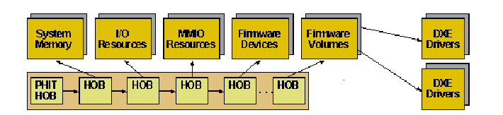
Pre-EFI Initialization (PEI) Phase Hand-Off Block (HOB)
The Handoff Block (HOB) is a binary data structure that contains the parameter to be passed from PEI to DXE
HOB is the only information that PEI passes to DXE

Slide 45
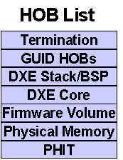
Pre-EFI Initialization (PEI) Phase HOB List
PEI Handoff Information Table (PHIT), containing Boot Mode information
Resource Descriptor for system memory
Resource Descriptor for firmware devices
System memory locations of the firmware volumes, contained within those firmware devices
DXE Core memory allocation
GUIDed HOB, allowing private information to be conveyed into the DXE driver from associated PEIM

Slide 46
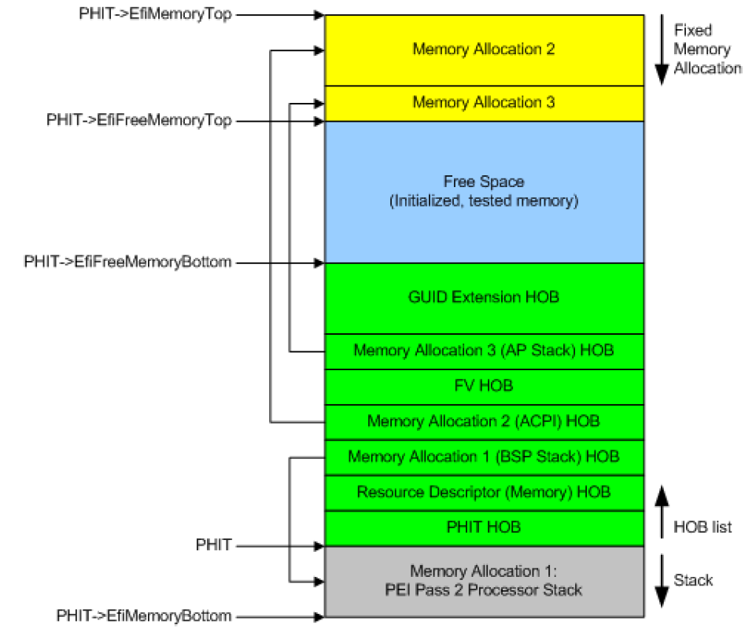
Pre-EFI Initialization (PEI) Phase HOB List

Slide 47
Pre-EFI Initialization (PEI) Phase PEI-to-DXE Transition
PEI
DXE
PEI
Pre-Memory
PEI
Post-Memory
Memory
Initialized
Last PEIM
DXE
IPL
HOB List
Termination
Firmware Volume
Physical Memory
DXE
MAIN
PHIT
HOB List
EFI System Table
EFI Boot Services Table
Memory-Only Boot Services
Termination
GUID HOBs
DXE Stack/BSP
DXE
Dispatcher
* PHIT – PEI Handoff Information Table
DXE Core
Firmware Volume
Physical Memory
PHIT

Slide 48
Driver Execution Environment (DXE)

Slide 49
Driver Execution Environment Platform Boot Flow
Pre Verifier
Verify
EFI/UEFI Interfaces
OS-Absent App
PEI Core
CPU Init
Device, Bus, or Service Driver
Transient OS Environment
Chipset Init
Transient OS Boot Loader
Board Init
EFI Driver Dispatcher
Boot Manager
OS-Present App
Architectural Protocols
Final OS Boot Loader
Final OS Environment
Security (SEC)
Pre EFI Initialization
(PEI)
Driver Execution Environment (DXE)
Boot Dev Select (BDS)
UEFI & OS Loader Handshake
Runtime (RT)
Power On
[..Platform Initialization..]
[..OS Boot..]
Shutdown

Slide 50
Driver Execution Environment Overview
The DXE phase is the phase where most of the system initialization is performed. It is loaded and executed once the PEI phase has initialized system memory in the platform.
Does all the setup procedures necessary for the OS Loader to boot the OS
Sets up the EFI System Tables and passes control to the BDS phase for booting the OS
Essence of DXE:
The DXE dispatcher dispatches DXE drivers in the right order.

Slide 51
Driver Execution Environment DXE Components
DXE Foundation
DXE Dispatcher
DXE Drivers
DXE Architectural Protocols
UEFI System Table

Slide 52
Driver Execution Environment DXE Components
DXE Foundation
The DXE Foundation consumes a HOB list and the services of the DXE Architectural Protocols to produce the full complement of UEFI Boot Services, UEFI Runtime Services, and DXE Services.

Slide 53
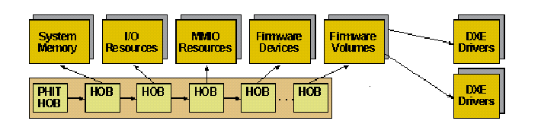
Driver Execution Environment PEI-to-DXE Entry
Entry
DXE
Core
DXE IPL
PEIM

Slide 54
Driver Execution Environment DXE Components
DXE Dispatcher
The DXE Dispatcher is one component of the DXE Foundation.
This component is required to discover DXE drivers stored in firmware volumes and execute them in the proper order.
The proper order is determine by a combination of an a priori file that is optionally stored in the firmware volume and the dependency expressions that are part of the DXE drivers.

Slide 55
Driver Execution Environment Dispatching DXE Drivers
DXE Core
DXE
Dispatcher
a priori file
A, B
Driver
A
Driver
B
Driver
C
Driver
D
Driver
E
After P_1
True
After P_1
Produce Protocol P_1
Dependency Expression

Slide 56
Driver Execution Environment DXE Components
DXE Drivers
The DXE drivers are responsible for initializing the processor, chipset, and platform components as well as providing software abstractions for system services, console devices, and boot devices.

Slide 57
Driver Execution Environment DXE Drivers
Early DXE Drivers
These early drivers will also typically produce the DXE Architectural Protocols that are required for the DXE Foundation to produces its full complement of UEFI Boot Services and UEFI Runtime Services.
DXE Drivers that follow the UEFI Driver Model
These drivers do not touch any hardware resources when they initialize.
Instead, they register a Driver Binding Protocol interface in the handle database.
The set of Driver Binding Protocols are used by the Boot Device Selection (BDS) phase to connect the drivers to the devices that are required to establish consoles and provide access to boot devices.

Slide 58
Driver Execution Environment Two Kinds of DXE Drivers
Type 1 (Non-Driver Model)
Not UEFI driver model
Runs early in the DXE phase
Performs initialization on the processor, chipset or platform
Produces the Architectural Protocols for the DXE Core to deliver services
Type 2 (Driver Model)
Complies with UEFI Driver Model
Performs no hardware initialization
Register Driver binding the protocol in Handle Database
Connects in the BDS phase

Slide 59
Driver Execution Environment Two Kinds of DXE Drivers – Non-Driver Model Driver
Non-Driver Model Driver:
EFI_CPU_ARCH_PROTOCOL gCpu = {
FlushCpuDataCache,
EnableInterrupt,
DisableInterrupt,
GetInterruptState,
Init,
RegisterInterruptHandler,
GetTimerValue,
SetMemoryAttributes,
1, // NumberOfTimers
4, // DmaBufferAlignment
};
Status = gBS->InstallProtocolInterface (
&NewHandle,
&gEfiCpuArchProtocolGuid,
EFI_NATIVE_INTERFACE,
&gCpu
);

Slide 60
Driver Execution Environment Two Kinds of DXE Drivers – Driver Model Driver
Driver Model Driver:
static EFI_DRIVER_BINDING_PROTOCOL mIsaAcpiDriver = {
IsaAcpiDriverSupported,
IsaAcpiDriverStart,
IsaAcpiDriverStop,
1,
NULL,
NULL
};
Status = EfiLibInstallDriverBinding (ImageHandle, SystemTable, &mIsaAcpiDriver, ImageHandle);

Slide 61
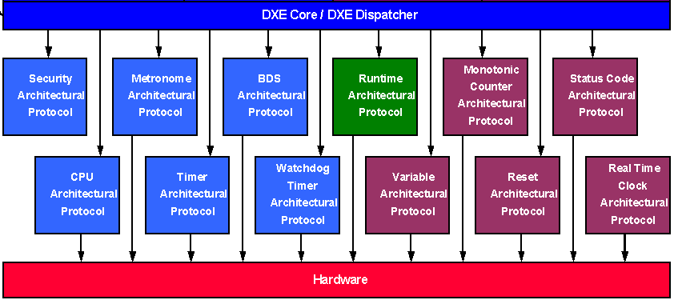
Driver Execution Environment DXE Architectural Protocols
EFI Boot Service Table
DXE Services
EFI System Table
EFI Runtime Service Table

Slide 62
Driver Execution Environment UEFI System Table
Active Consoles
EFI
EFI Runtime Services Table
Input Console
System
Real-Time Clock Services
Output Console
Table
Virtual Memory Services
Standard Error Console
Variable Services
Reset Services
EFI Boot Services Table
Capsule Services
Task Priority Level Services
Memory Services
Version Information
Event and Timer Services
EFI Specification Version
Protocol Handler Services
Firmware Vendor
Image Services
Firmware Revision
Driver Support Services
System Configuration Table
DXE Services Table
DXE Services Table
Global Coherency Domain Services
HOB List
Dispatcher Services
ACPI Table
SMBIOS Table
Handle Database
Protocol Interface
…
Protocol Interface
Protocol Interface
Protocol Interface
SAL System Table
Protocol Interface
Protocol Interface
Boot Services and Structures
Runtime Services and Structures
Only available before the OS runtime
Available before and during OS runtime

Slide 63
Driver Execution Environment UEFI System Table – EFI_SYSTEM_TABLE
typedef struct {
EFI_TABLE_HEADER Hdr;
CHAR16 *FirmwareVendor;
UINT32 FirmwareRevision;
EFI_HANDLE ConsoleInHandle;
EFI_SIMPLE_TEXT_INPUT_PROTOCOL *ConIn;
EFI_HANDLE ConsoleOutHandle;
EFI_SIMPLE_TEXT_OUTPUT_PROTOCOL *ConOut;
EFI_HANDLE StandardErrorHandle;
EFI_SIMPLE_TEXT_OUTPUT_PROTOCOL *StdErr;
EFI_RUNTIME_SERVICES *RuntimeServices;
EFI_BOOT_SERVICES *BootServices;
UINTN NumberOfTableEntries;
EFI_CONFIGURATION_TABLE *ConfigurationTable;
} EFI_SYSTEM_TABLE;

Slide 64
Driver Execution Environment UEFI System Table – EFI Boot Services
Event, Timer, Task Priority Services
Memory Allocation Services
Protocol Handler Services
Image Services
Miscellaneous Services
EFI Boot Services Table
Task Priority Level Services
Not Valid
Memory Services
Event & Timer Services
Protocol Handler Services
Image Services
Driver Support Services
ExitBootServices()

Slide 65
Driver Execution Environment UEFI System Table – EFI Runtime Services
Time Services
Virtual Memory Services
Variable Services
Miscellaneous Services
Capsule Services
EFI Runtime Services Table
Real-Time Clock Services
Virtual Memory Services
Variable Services
Reset Services
Capsule Services
SetVirtualAddressMap()

Slide 66
Driver Execution Environment Handle Database
HandleDatabase
Handle
GUID
Interface
DXE Driver
GUID
Interface
...
...
Protocol Interface
Function Pointer
Function Pointer
BlkIo->ReadBlocks(BlkIo, …)
...
Device-Specific
Context

Slide 67
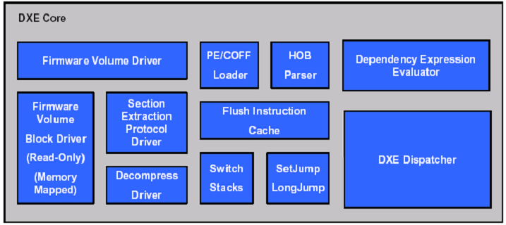
Driver Execution Environment DXE Phase Flow
DXE
Driver
Firmware Volumes
System Memory
a priori file
DXE
Driver
DXE
Driver

Slide 68
Driver Execution Environment End of the Dispatcher
The dispatcher ends when there is no more driver to be dispatched
BDS begins execution
DXE
Dispatcher
DXE
Core
List of GUIDs
Completed
Dispatching Drivers
BDS.Entry
gEfiBdsArchProtocolGuid
struct _EFI_BDS_ARCH_PROTOCOL {
EFI_BDS_ENTRY Entry;
};

Slide 69
Boot Device Selection (BDS)

Slide 70
Boot Device Selection (BDS) Phase Platform Boot Flow
Pre Verifier
Verify
EFI/UEFI Interfaces
OS-Absent App
PEI Core
CPU Init
Device, Bus, or Service Driver
Transient OS Environment
Chipset Init
Transient OS Boot Loader
Board Init
EFI Driver Dispatcher
Boot Manager
OS-Present App
Architectural Protocols
Final OS Boot Loader
Final OS Environment
Security (SEC)
Pre EFI Initialization
(PEI)
Driver Execution Environment (DXE)
Boot Dev Select (BDS)
UEFI & OS Loader Handshake
Runtime (RT)
Power On
[..Platform Initialization..]
[..OS Boot..]
Shutdown

Slide 71
Boot Device Selection (BDS) Phase Overview
The BDS phase is responsible for implementing the platform boot policy.
The BDS phase is responsible for the following:
Initializing console devices
Loading device drivers
Attempting to load and execute boot selections
The BDS phase is implemented as part of the BDS Architectural Protocol.

Slide 72
Boot Device Selection (BDS) Phase Overview
The DXE Foundation will hand control to the BDS Architectural Protocol after all of the DXE drivers whose dependencies have been satisfied have been loaded and executed by the DXE Dispatcher.

Slide 73
Boot Device Selection (BDS) Phase Overview
Connect PCI Bus driver for PCI resource assignment and install PCI IO protocol to each of PCI device’s Handle.
Connect default console In and console Out device.
Display splash logo or system information on screen
Connect all devices and drivers
Enumerate all boot option device
Boot to OS

Slide 74
Boot Device Selection (BDS) Phase EFI_BDS_ARCH_PROTOCOL
Transfers control from the DXE phase to an operating system or system utility.
typedef struct {
EFI_BDS_ENTRY Entry;
} EFI_BDS_ARCH_PROTOCOL;

Slide 75
Boot Device Selection (BDS) Phase Booting Sequence
EFI Driver
EFI Application
EFI Bootcode
OS Loader
Retry
Failure
Platform Init
EFI Image Load
EFI OS Loader Load
Boot Services Terminate
Standard firmware platform initialization
Drivers and applications loaded iteratively
Boot from ordered list of EFI OS loaders
Operation handed off to OS loader

Slide 76
Firmware Storage

Slide 77
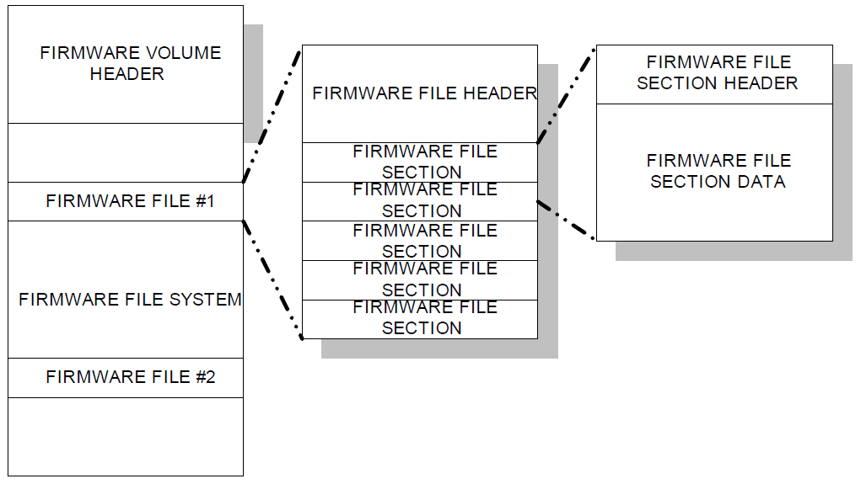
Firmware Storage Firmware Devices
A firmware device is a persistent physical repository that contains firmware code and/or data.

Slide 78
Firmware Storage Firmware Volumes
A Firmware Volume (FV) is a logical firmware device.
Analogous to a disk volume or partition
Typically more than one in a system
Each firmware volume is organized into a file system.
Each firmware volume has the following attributes:
Name. Each volume has a name consisting of an UEFI Globally Unique Identifier (GUID).
Size. Each volume has a size, which describes the total size of all volume data, including any header, files, and free space.

Slide 79
Firmware Storage Firmware File Systems
A firmware file system (FFS) describes the organization of files and (optionally) free space within the firmware volume.
Each firmware file system has a unique GUID, which is used by the firmware to associate a driver with a newly exposed firmware volume.
The PI Architecture Firmware File System is a binary layout of file storage within firmware volumes.
It is a flat file system in that there is no provision for any directory hierarchy; all files reside in the root directly.

Slide 80
Firmware Storage Firmware File Systems
Analogous to a FAT32 or NTFS disk
Consists of files that are the base unit of storage for Framework Firmware
Binary format
Organization of FV data space
Defines file header format
Must follow Framework image format
All files are contiguous from the bottom of the FV
Free space is at the top of the FV
File names are GUIDs to prevent name collisions

Slide 81
Firmware Storage Firmware File
Firmware files are code and/or data stored in firmware volumes.
Each of the files has the following attributes:
Name. Each file has a name consisting of an UEFI GUID. File names must be unique within a firmware volume. Some file names have special significance.
…

Slide 82
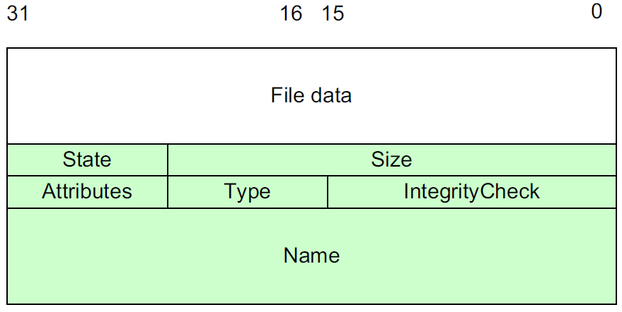

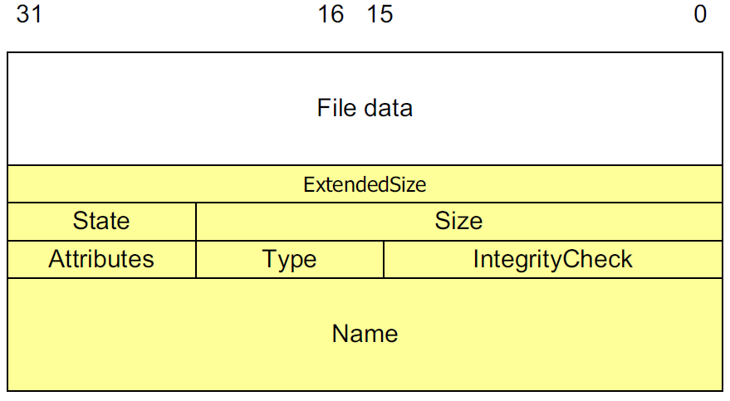

Firmware Storage Firmware Files

Slide 83
Firmware Storage Firmware File Sections
Firmware file sections are separate discrete “parts” within certain file types.
Encapsulation sections
Leaf sections
E1
Complete file image
L5
E2
L4
Encapsulation section (En)‏
L3
Leaf section (Ln)‏
L2
E0
L1
L0

Slide 84
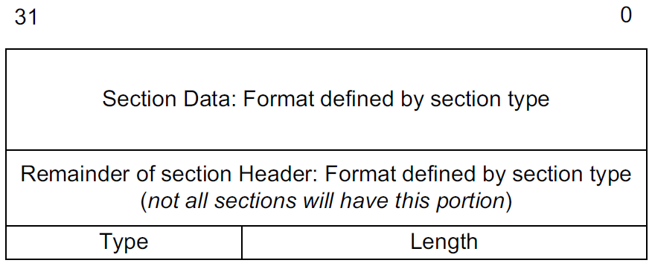
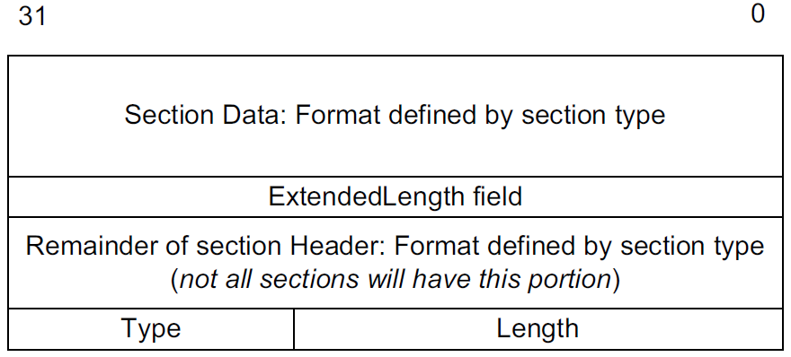
Firmware Storage Firmware File Sections

Slide 85
Firmware Storage BFV – Boot Firmware Volume
Stored in the Flash. Follows the EFI Firmware File System (FFS)
Contains PEI Core and PEI Modules (PEIMs)
It’s memory mapped location is known by SEC during startup

Slide 86
Thanks!
For more information, contact:
employee@insyde.com

